Slide 1
Python Lab
- Kiran Ghadigaonkar

Slide 2
Agenda
01
Understanding the Problem Statement
02
Solution Approach 1 : Brute Force Method
Table of Contents
03
Solution Approach 2: Optimised Method
04
Python Implementation
5
Appendix: Python code explanation

Slide 3
Problem Statement
You are given a list that can contain positive and negative integers. Write a program to find two elements such that their sum is closest to zero.
Sample Input 1: [-4, 7, 6, 2, -5]
Sample Output 1: (-5, 6)
Test Case 1
Sample Input 2: [-50, 34, -19, 24, 33, 10, -46, -38]
Sample Output 2: (-38, 34)
Test Case 2

Slide 4
Solution 1: Brute Force Approach
The brute force method for finding two elements in a given list whose sum is closest to zero involves:-
Comparing the sum of every pair of elements
Keeping track of the pair with the minimum absolute difference from zero.
Time Complexity: O(n^2) Limitations: The brute force method has a time complexity of O(n^2), where n is the length of the input list. Therefore, it may not be efficient for large input lists.

Slide 5
Solution 2: Optimised Method
The optimized method for finding two elements in a given list whose sum is closest to zero is based on a two-pointer approach, which takes advantage of the fact that the list is sorted.
Time Complexity: O(n log n) Limitations: The optimized approach has a time complexity of O(n log n) due to the sorting step, where n is the length of the input list. This approach is more efficient than the brute force method for larger input lists.

Slide 6
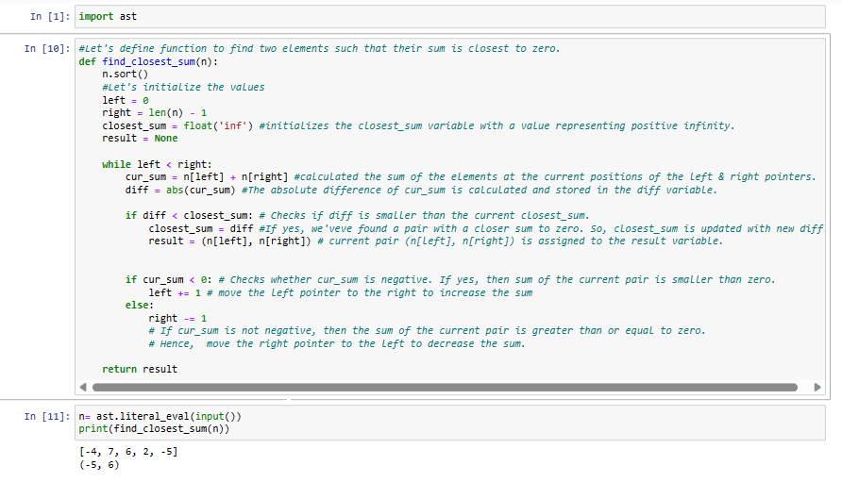
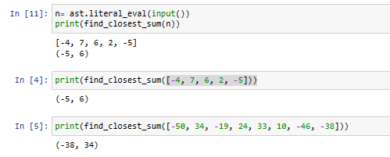
Python Implementation
Python Coding
Input and Output

Slide 7
Appendix: Python code explanation
Define function by sorting the input list n using the sort() method.
Intialize variables i.e. left and right pointers. The left pointer starts from the leftmost position (index 0), and the right pointer starts from the rightmost position (index len(n) - 1).
The variable closest_sum is initialized with a value representing positive infinity using float('inf').
The result variable is initially set to None. It will hold the pair of elements with the closest sum to zero.
The while left < right loop iterates until the left pointer becomes greater than or equal to the right pointer.
Inside the loop, the sum of the elements at the current positions of the left and right pointers is calculated and stored in the variable cur_sum.
The absolute difference of cur_sum is computed using the abs() function and stored in the variable diff.
The code checks if diff is smaller than the current value of closest_sum. If yes, then the closest_sum is updated with the new diff, and the current pair (n[left], n[right]) is assigned to the result variable.
Now, the code checks whether cur_sum is negative. If yes, then it means the sum of the current pair is smaller than zero, and we need to move the left pointer to the right to increase the sum.
If cur_sum is not negative, then, we need to move the right pointer to the left to decrease the sum.
The left and right pointers are updated accordingly within the loop.
Once the loop completes, the function returns the result variable, which contains the pair of elements with the closest sum to zero. To summarize, this optimized method efficiently finds the pair of elements with the closest sum to zero by utilizing a two-pointer approach on a sorted list. By comparing the differences and updating the closest sum accordingly, it iterates through the list in a way that eliminates the need for exhaustive pair comparisons. Python Code explanation documents

